Slide 1

DATA PRIVACY ACT OF 2012

Slide 2
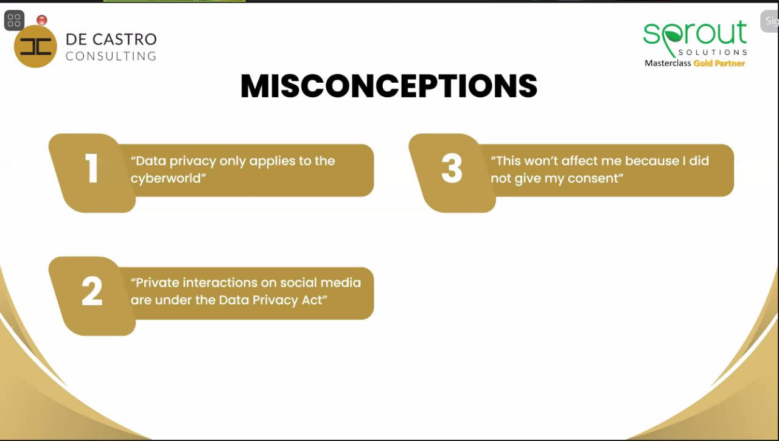

Slide 3
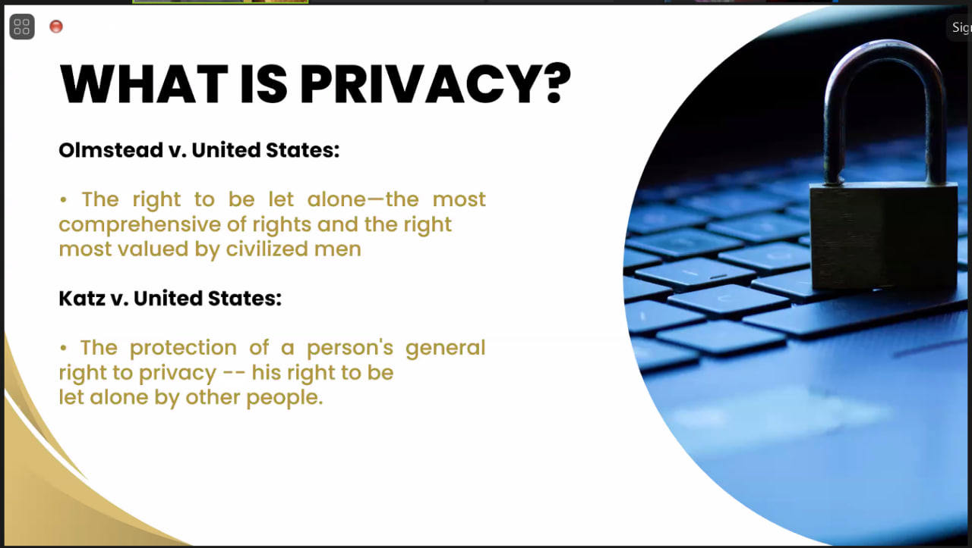

Slide 4


Slide 5


Slide 6


Slide 7
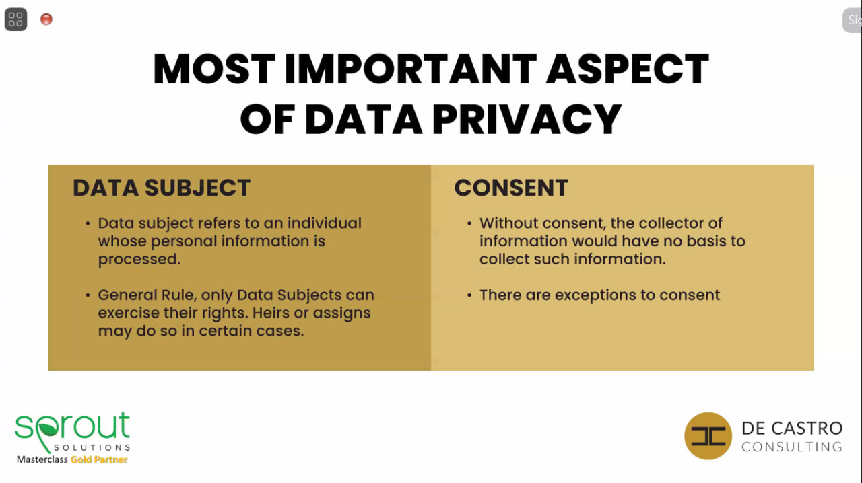

Slide 8
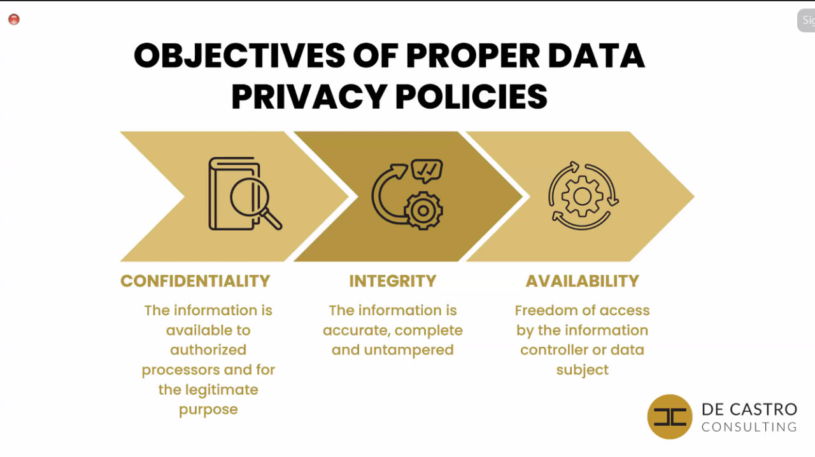

Slide 9
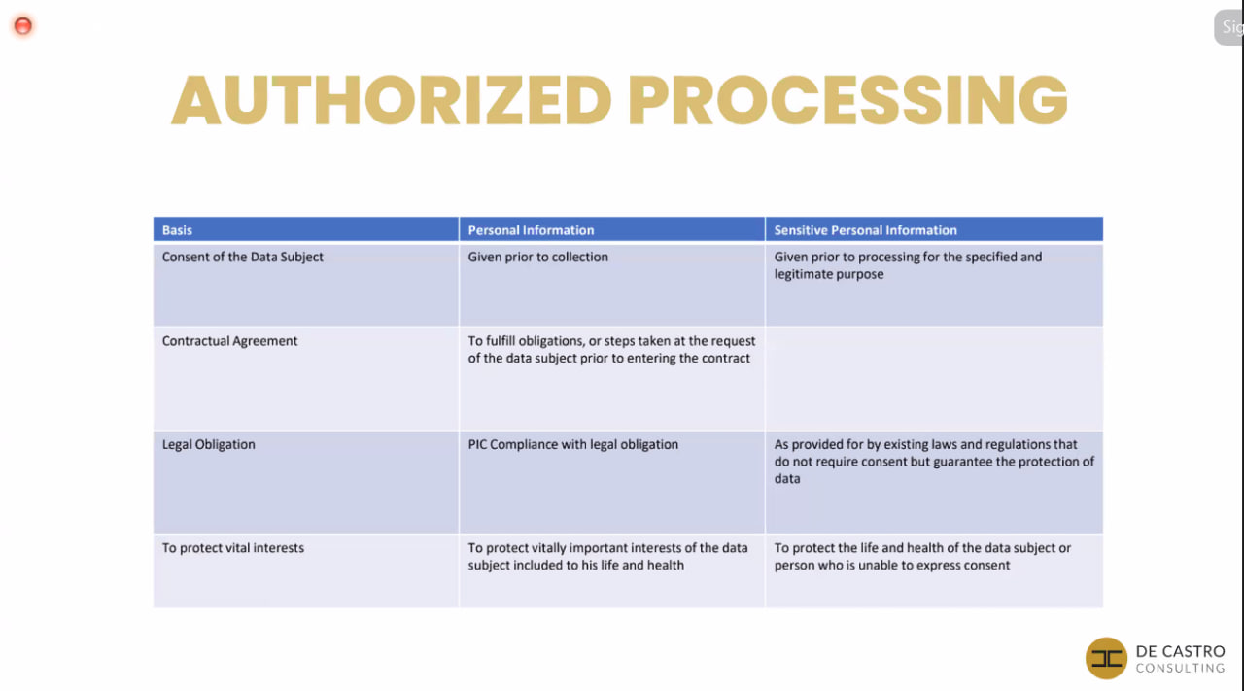

Slide 10
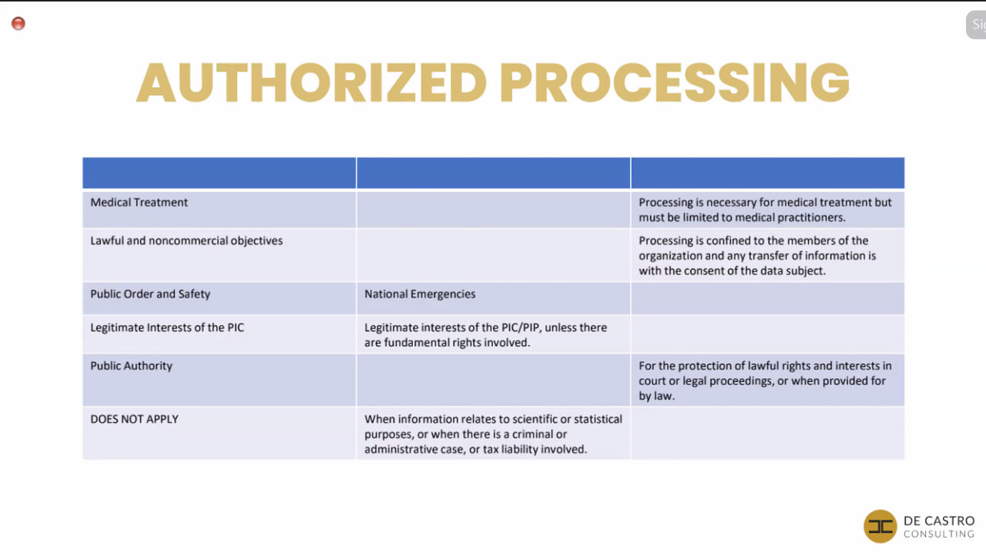

Slide 11


Slide 12


Slide 13
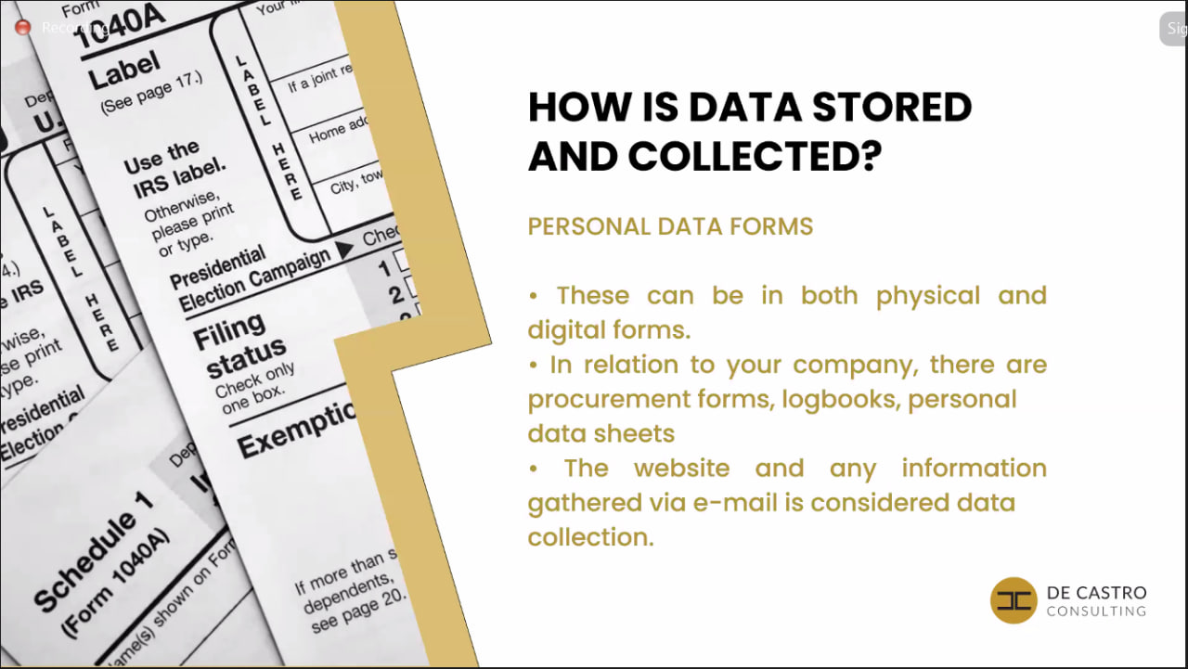

Slide 14

EXAMPLES of Personal data
Name and surname
Home address
Email address such as name.surname@company.com
Identification card number
Location data (e.g location data function on a mobile phone)
Internet Protocol (IP) address
Cookie ID
Advertising identifier of your phone
Etc.

Slide 15
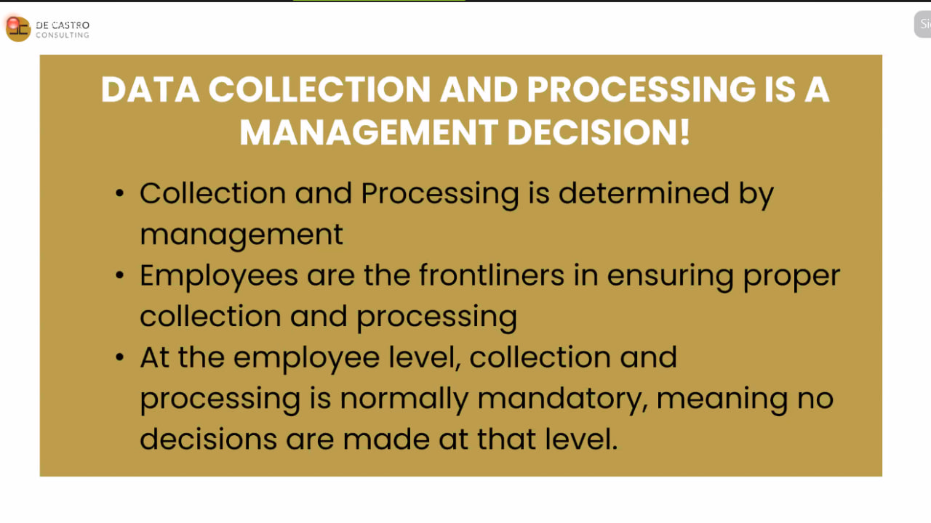

Slide 16
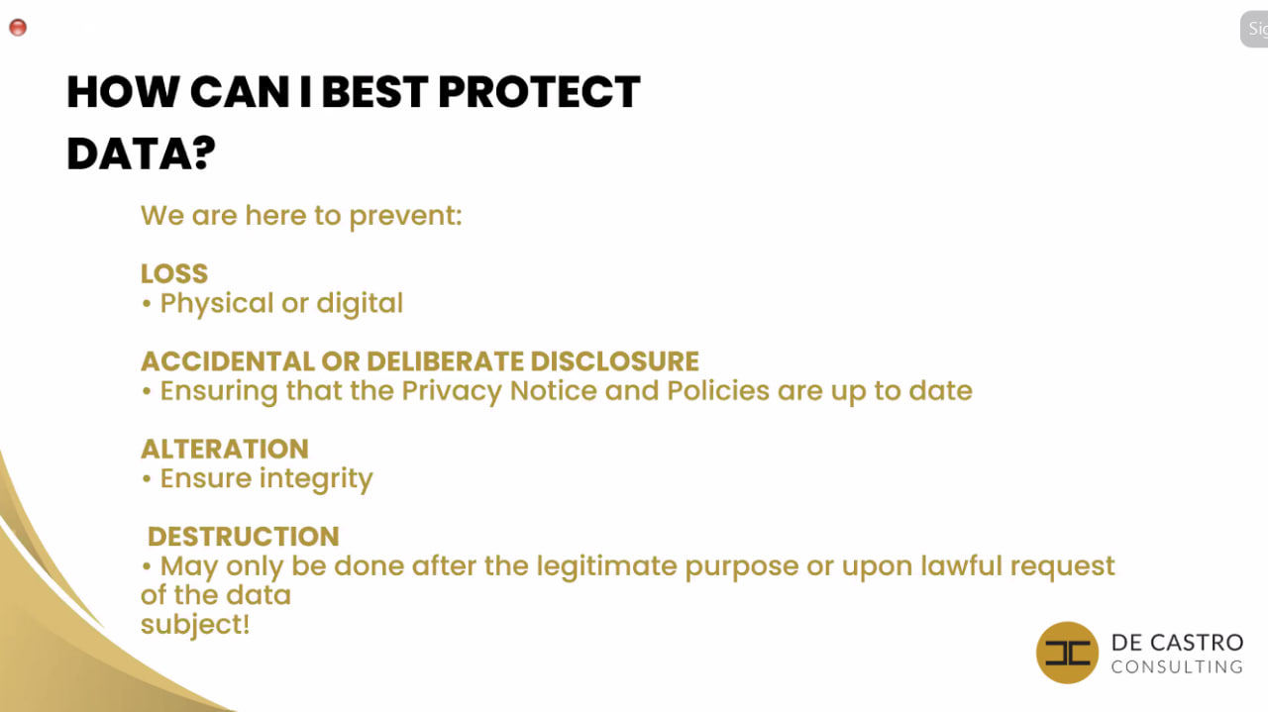

Slide 17
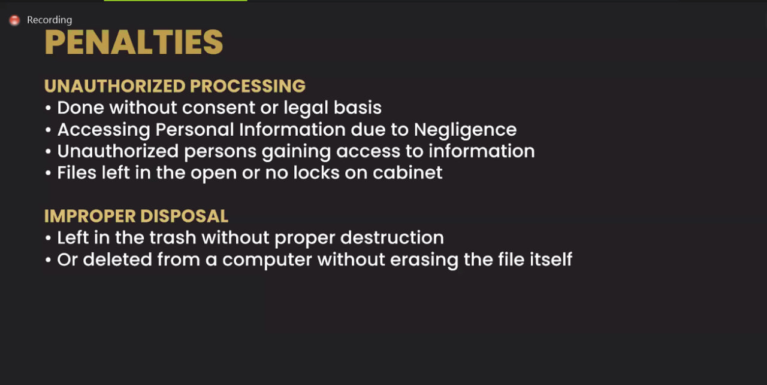

Slide 18
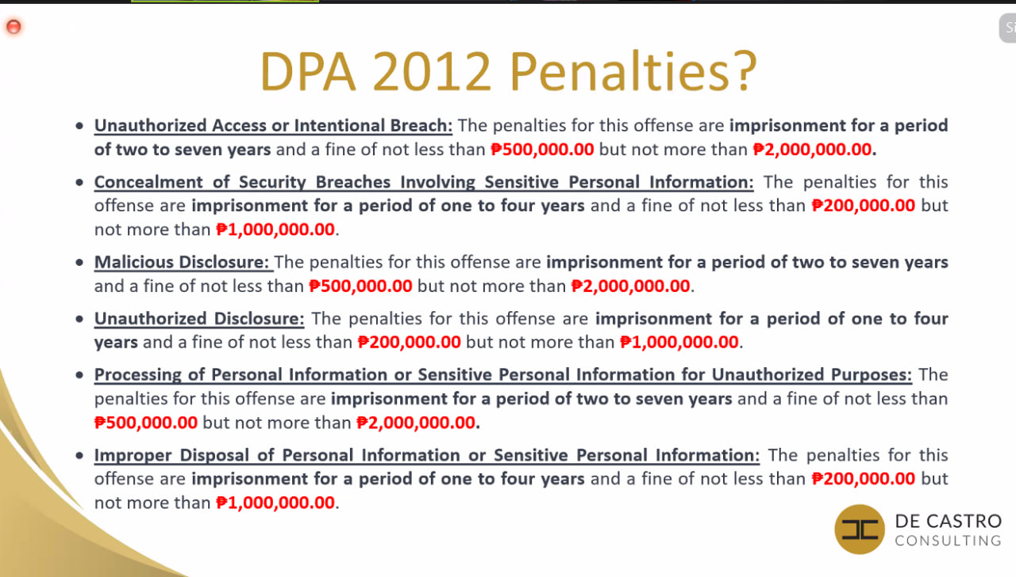

Slide 19
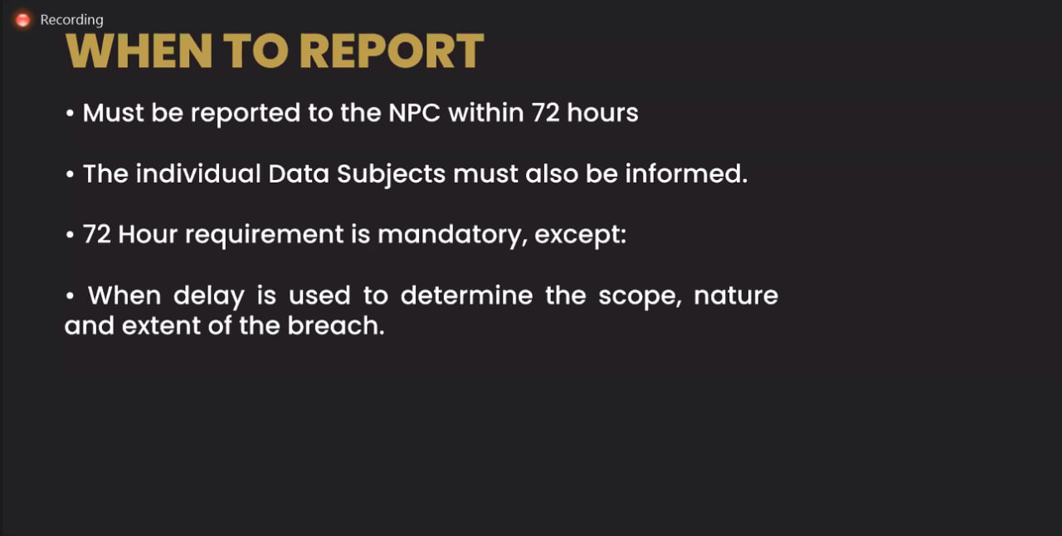

Slide 20


Slide 21
End of Presentation
Thank you!

